Slide 1





Master of Technology (IS)
Pepper Project Group
CAO LIANG | A0012884E
GENG LIANGYU | A0195278M
HAN DONGCHOU FRANCIS | A0195414A
ONG BOON PING | A0195172B
TAN CHIN GEE | A0195296M
Patient Matching System
Depression Screening System
Project Report

Slide 2
Contents
Executive Summary 3
Business Problem Background 4
Project Objectives & Success Measurement 5
Project Solution 6
Project Implementation 10
Project Performance & Validation 28
Project Conclusions: Findings & Recommendation 30

Slide 3
Executive Summary
This project is a continuation from the Depression Screening System group project completed during the Machine Reasoning course. As a recap, the Depression Screening System deals with the problem of depression in youths and vulnerable segments of the community going undetected and untreated. It serves as an early warning system to put a spotlight on those vulnerable individuals who are displaying symptoms of depression. These vulnerable individuals can be spotted through the PHQ-9 Survey framework devised with the Depression Screening System. The output from that system is to provide a diagnosis (with a PHQ-9 score) on the level of severity of depression the individuals are having.
In this phase of project, the objective is to use the PHQ-9 scores of the individuals and match them to the many practitioners in the community partners, hospitals and IMH.
Why Patient Matching? When we churn out a list of patients in batches as part of the PHQ-9 Survey, there is also a need to do the matching with practitioners in batches. There are some challenges to match patients to practitioners. First of all, practitioners fall into roughly 3 categories – Counsellors, Psychologists, Psychiatrists. Then there is the time availability of the practitioners, as well as language ability, which are all hard constraints. Also there is location preference and gender preference which are soft constraints. Then there is the cost based on the practitioner selected, which is a soft constraint to minimize it.
Using the State Space Search techniques embedded in the OptaPlanner, the Patient Matching System is able to optimally match a group of patients against a group of practitioners. The detail of how this match is executed will be covered in the next chapters.
This system provides benefits to those who are diagnosed with depression by matching appropriate practitioners with the right expertise and in accordance to some set constraints.

Slide 4
Business Problem Background
In the Depression Screening System, the test candidates are given the PHQ-9 scores indicating the level of severity of the depression.
With the current project, the Patient Matching System matches patients with mental health practitioners based on two hard constraints and four soft constraints. The hard constraints are patients’ depression severity and language ability. The soft constraints are patients’ preferences for the day of the appointment, where the practitioners are located, gender of the practitioners, and treatment costs.
Starting with the hard constraints, our system scores the severity of a patient’s depression with a number from 0 to 27. Patients with scores between 10 to 27 require treatment. A score between 10 to 14 indicates that a patient is moderately depressed, and the patient should see a counsellor. A score between 15 to 19 indicates that a patient’s depression is moderately severe, and the patient should see a psychologist. A score between 20 to 27 indicates that a patient is severely depressed, and the patient should see a psychiatrist.
Patients and mental health practitioners need to communicate and understand each other during treatment. The system pairs patients with mental health practitioners who share at least one language in common. Patients and mental health practitioners can speak one or more of these languages: English, Mandarin, Malay or Tamil.
Our system optimizes the matching of patients with practitioners through fulfilling four soft constraints. Patients will indicate a day of the week, Monday to Sunday, that they preferred to see the practitioners. The system will try to match patients with practitioners who are available on the preferred day.
Patients will indicate where they would prefer to see the practitioners. There are five regions to choose from: Central, East, North, Northeast, and West. The system will try to match patients with practitioners working in their preferred regions.
Patients will indicate whether they prefer to see female or male practitioners which the system will try to match accordingly.
Finally, the system will try to pair patients with practitioners that have lower treatment costs to keep the overall healthcare expenditure low.

Slide 5
Project Objectives & Success Measurement
The objective of this project is to optimally match patients with practitioners, both in groups. The outcome of this match will be such that all patients will be assigned matching practitioners.
We will be monitoring whether the system is able to meet the hard constraints and soft constraints during this matching exercise to see how good the application is in tackling hard constraints and minimizing soft ones. This will provide us with a gauge as to how well the application is able to perform the matches.
The hard constraints are
patients’ depression severity
language ability
The soft constraints are
patients’ preferences for the day of the appointment
where the practitioners are located
gender of the practitioners
treatment costs.
Notes:
One in four young Singaporeans show signs of depression. IMH treated 600 youths between 20 to 29-years-old last year alone.
And one out of four people admitted to suffering from multiple symptoms of depression in a recent survey of youths aged 18 to 25. The study was conducted by students from Wee Kim Wee School of Communication and Information in NTU.
We know that depression may lead to suicide. But other times, its sufferers become less productive and are more at risk for other diseases.
The latest statistics on depression don’t paint a pretty picture of progress but it shows that the condition is more common than we think. Yet the stigma surrounding it walls off the victim who often suffers in silence.
We need to seek out those who need help, and help them early. However, the challenge is that we do not have enough practitioners to do that.
One way to tackle this problem is to adopt a pro-active approach to seek out those who need professional assistance. The objective of this project serves to do just that with the help of Artificial Intelligence. With AI, we could apply some techniques like Certainty Factor, Decision Tree, and Inference Diagram to automate the screening of candidates. The screening is done at three levels:
Identifying the high risk group – Risk Profiling
Doing a 2-question survey (PHQ2)
Doing a 7-question survey (PHQ9)
Level #1 can be applied to any organization, be it a school, a workplace, or even just targeting a segment of people.
Once level #1 is done, those identified candidates can proceed to Level #2 and level #3 in a survey setting so that we can ascertain whether the candidate would likely be suffering from depression, and then recommending the next steps.

Slide 6
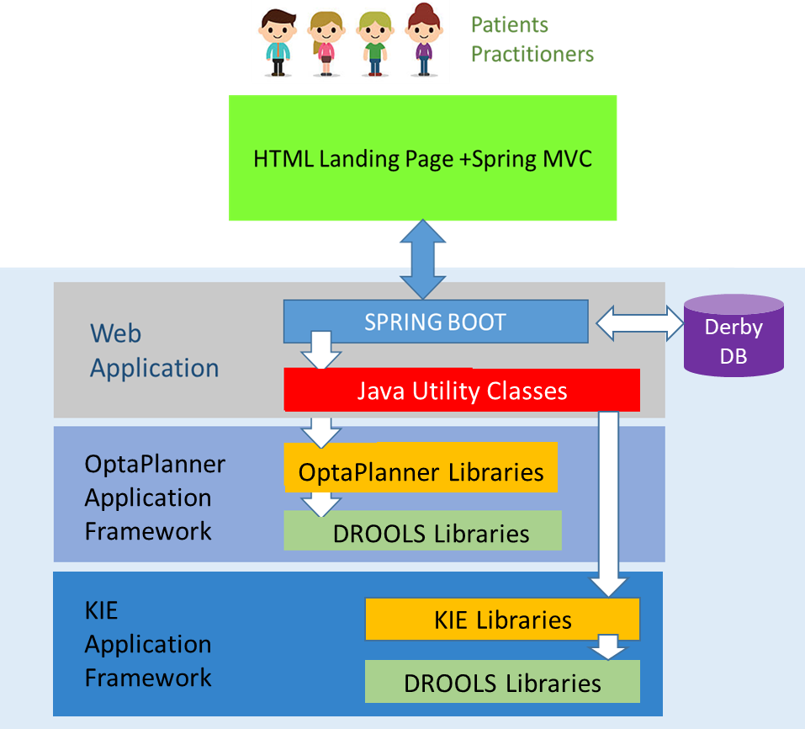
Project Solution
Architecture
This application leverages the combination of KIE Application Framework with Optaplanner libraries, DROOLS libraries, custom Java Classes and Spring Boot for development, testing and deployment. We utilized the KIE for metadata and workflow, DROOLS for rules engine, Optaplanner for matching the patients with practitioners and the JBOS Web Server to provide the web application server functions. In addition, we used the Spring Boot to program the web application, landing page, and interface with KIE.
A lot of effort was spent on integrating the Spring Boot web application with the KIE framework, DROOLS libraries and Optaplanner libraries through our self-coded Java classes.
This allows the user to not only interface with an external HTML page but also stay on the HTML frontend throughout the entire process.

Slide 7
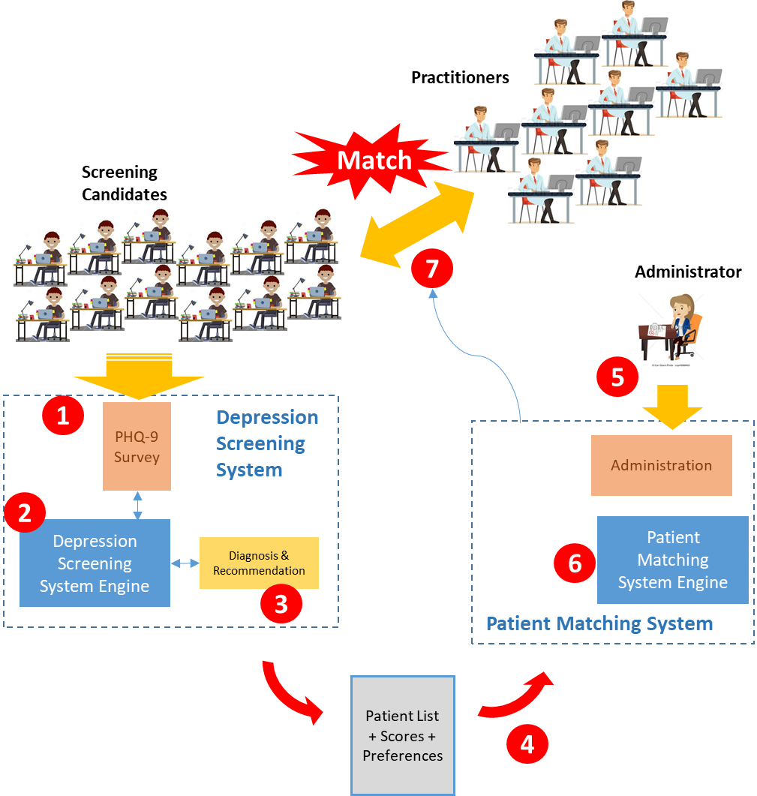
Project Solution
Process Flow
Candidates undergo screening process by taking part in the PHQ-9 online survey
The Rules Engine of the KIE Workbench churns out the scores for the candidates
Based on the scores, the candidates are grouped into the different severity levels
The list of patients and the respective scores and preferences are sent in batches to the Patient Matching System
An administrator can then activate a match
The Patient Matching System engine will start to leverage the OptaPlanner system
The patients are matched to the practitioners based on the hard and soft constraints
MR Project
RS Project

Slide 8
Project Solution
Design Strategy
In trying to establish the most optimal search method, we took reference from the following guideline found in the Optaplanner documentation (extract below).
Following this guideline, we adopted the First Fit Decreasing Search Method at the start and then tuned further for search improvements. Details are laid out in the subsequent slides.
Reference: https://docs.optaplanner.org/6.1.0.Beta4/optaplanner-docs/html/optimizationAlgorithms.html
Which optimization algorithms should I use?
The best optimization algorithms configuration for your use case depends heavily on your use case. Nevertheless, this vanilla recipe will get you into the game with a pretty good configuration, probably much better than what you're used to.
Start with a quick configuration that involves little or no configuration and optimization code:
First Fit
Next, implement planning entity difficulty comparison and turn it into:
First Fit Decreasing
Next, add Late Acceptance behind it:
First Fit Decreasing
Late Acceptance. A late acceptance size of 400 usually works well.
At this point the free lunch is over. The return on invested time lowers. The result is probably already more than good enough.
But you can do even better, at a lower return on invested time. Use the Benchmarker and try a couple of different Tabu Search, Simulated Annealing and Late Acceptance configurations, for example:
First Fit Decreasing
Tabu Search. An entity tabu size of 7 usually works well.
Use the Benchmarker to improve the values for those size parameters.
If it's worth your time, continue experimenting further. For example, you can even combine multiple algorithms together:
First Fit Decreasing
Late Acceptance (relatively long time)
Tabu Search (relatively short time)

Slide 9
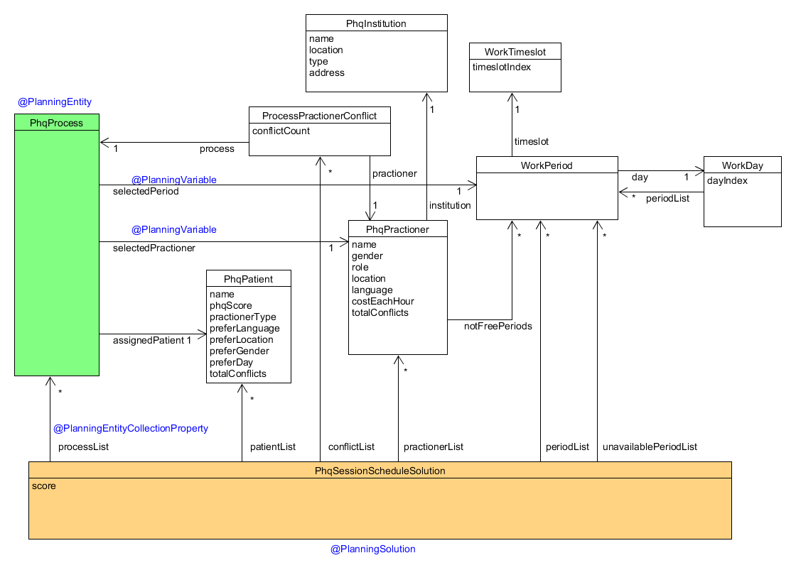
Project Solution
Design – Class Diagram
The following figure shows the Class Diagram for the application. This class diagram shows that, using OptaPlanner, we are trying to match a group of patients to a group of practitioners based on Period and Practitioner.
Following is the journey that we adopted.
We started on the KIE Workbench to prototype the application and then migrated to Eclipse and incorporated Java Maven libraries
A note that on the KIE environment, we realized that the memory process is intensive and the OptaPlanner is limited to few functions (eg cannot tune the late acceptance properties)
Also, using Java Maven libraries brought about some enhancement to the model
We evolved the Data Objects as we moved along, resulting in the following Class Diagram

Slide 10
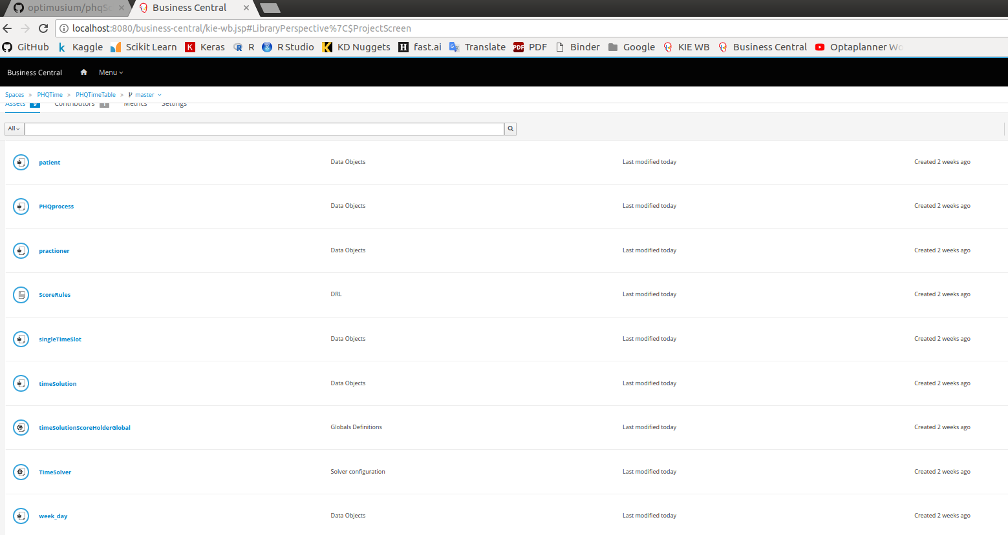
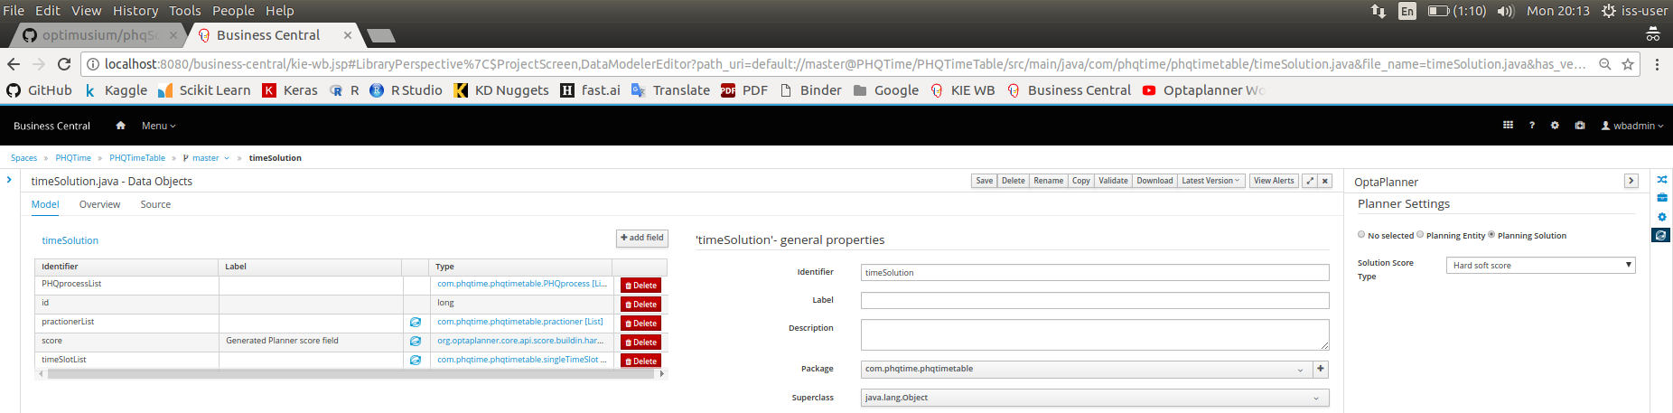
Project Implementation
KIE Workbench Setup
The following screens shows the setup… - to update.

Slide 11
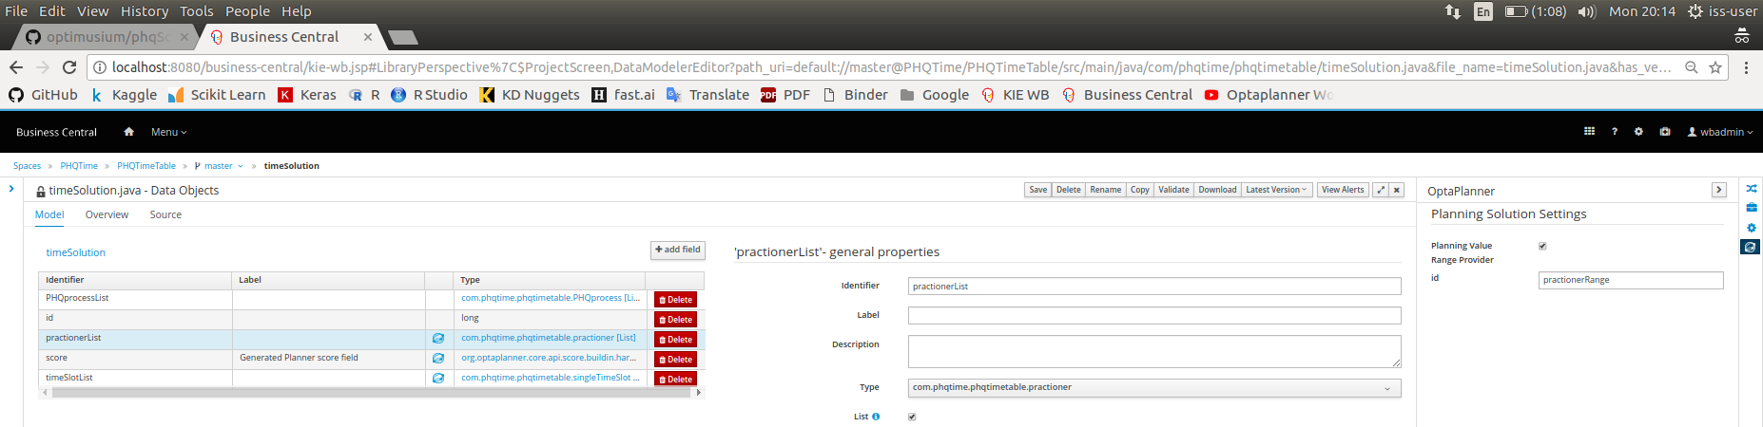

Project Implementation
KIE Workbench Setup

Slide 12
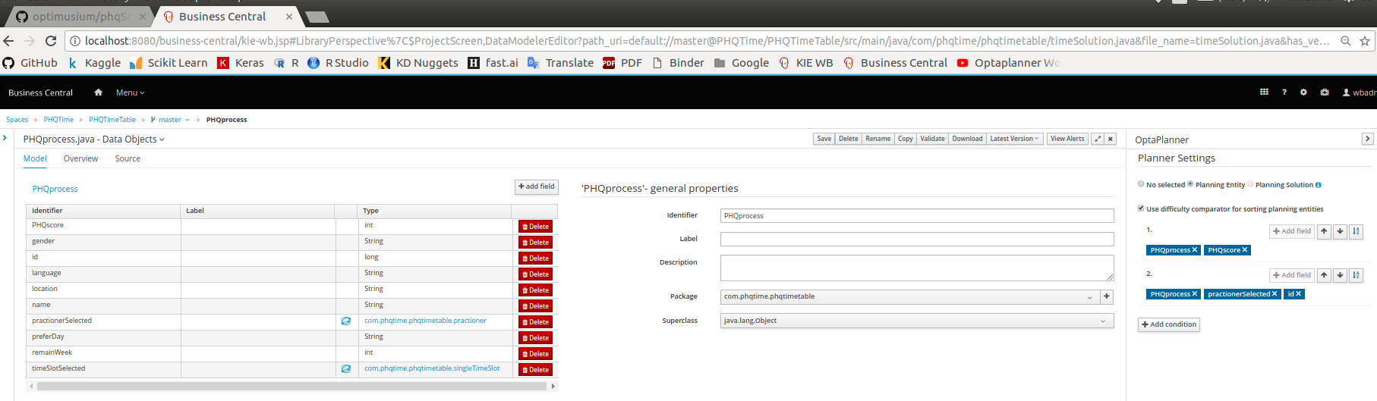
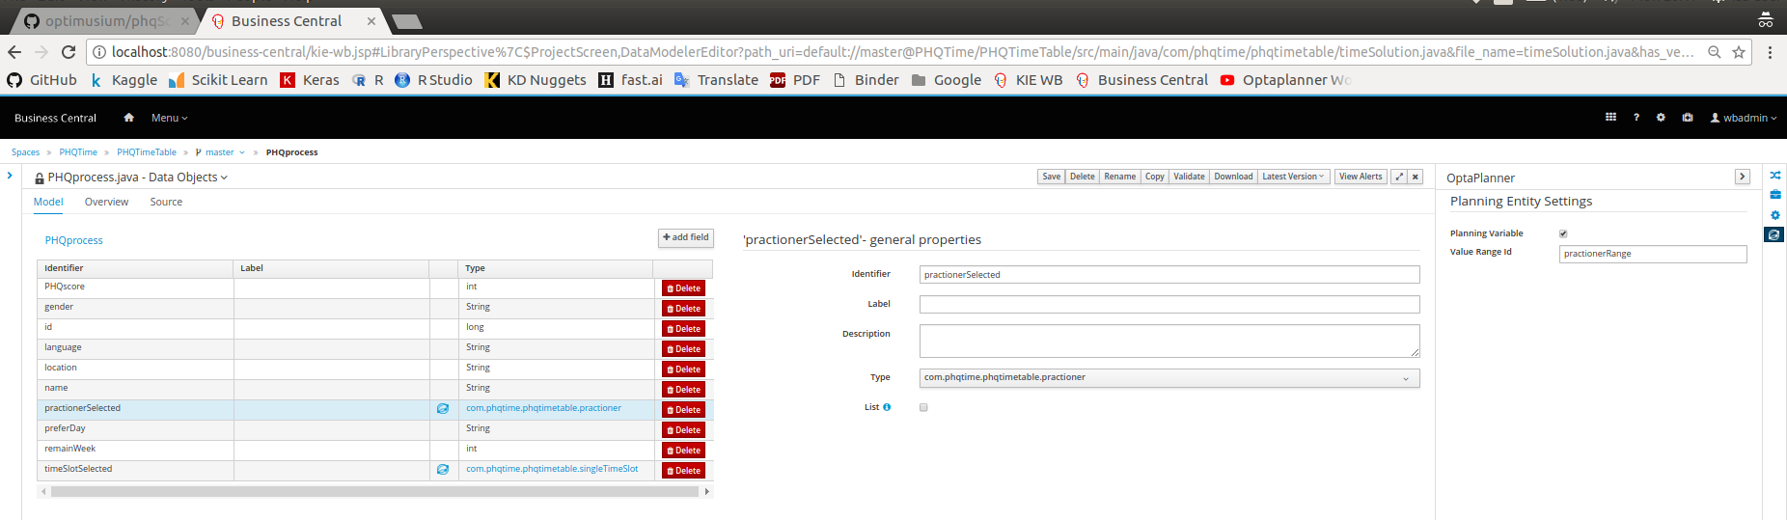
Project Implementation
KIE Workbench Setup

Slide 13
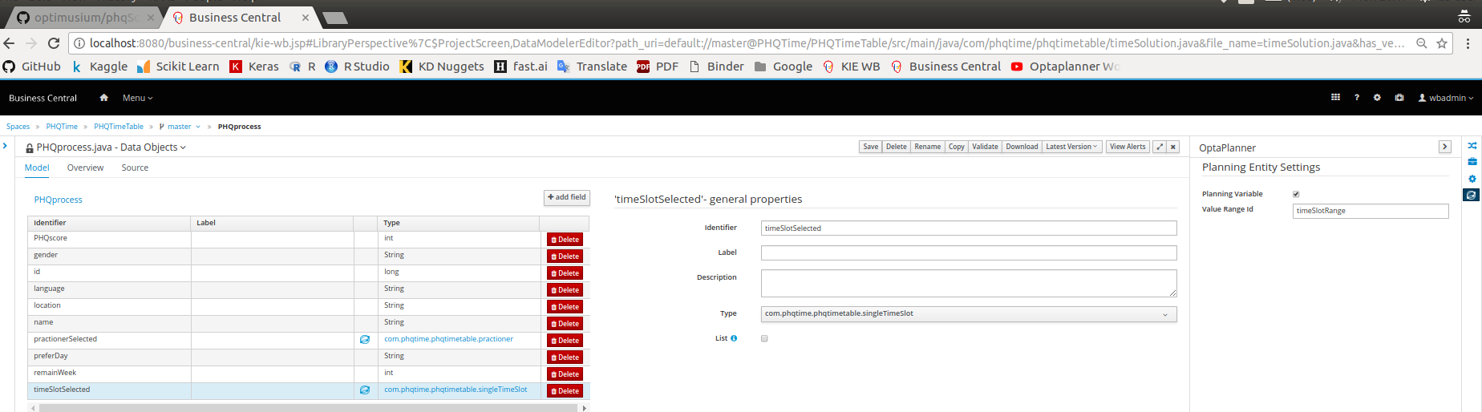
Project Implementation
KIE Workbench Setup

Slide 14
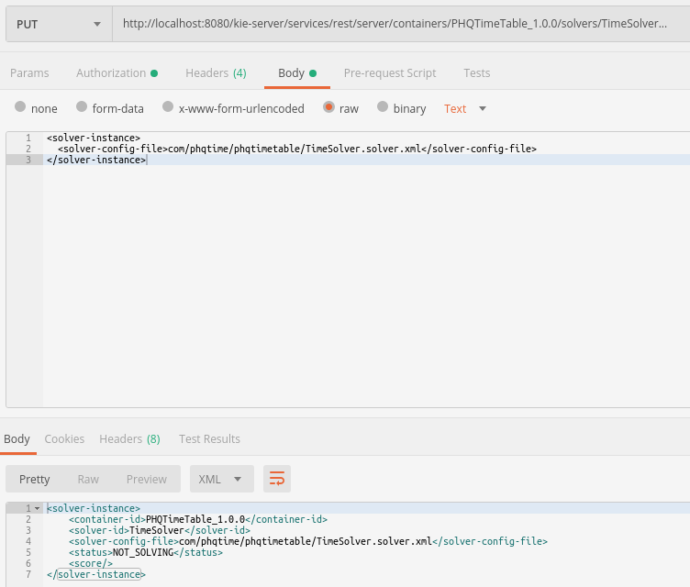
Project Implementation
KIE Workbench Setup
Next we use the Tool Postman to test the OptaPlanner application.

Slide 15
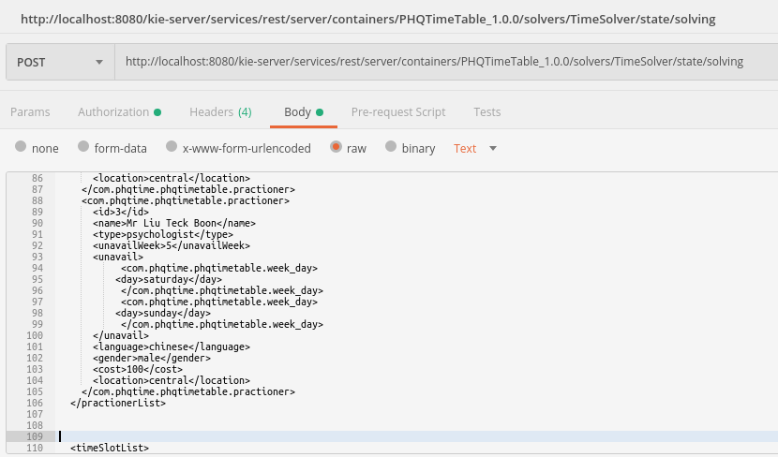
Project Implementation
KIE Workbench Setup
When using the construction heuristics, we choose to use First Fit Decreasing. This is to enable us to quickly construct the initial solution.
We started with a very simple search consisting of 3 patients and 3 practitioners, using First Fit Decreasing.
As the State Search Space got larger however, we realize that First Fit Decreasing does not work very well.
Initial testing for First Fit Decreasing with only 3 practitioners and 3 patients

Slide 16
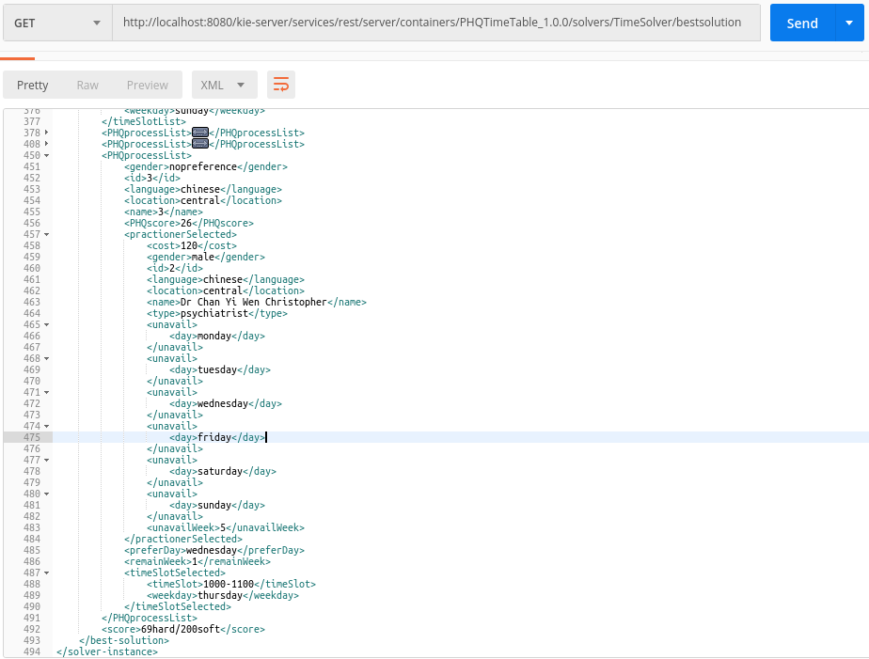
Project Implementation
KIE Workbench Setup
The search outcome for First Fit Decreasing with the small Data Set is successful with a Hard score of 69 and a Soft score of 200.

Slide 17
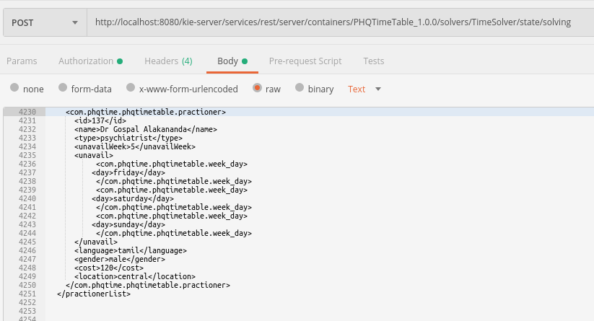
Project Implementation
KIE Workbench Setup
Next we perform a test on this First Fit Decreasing search with a bigger data set → 137 practitioners and 134 patients

Slide 18
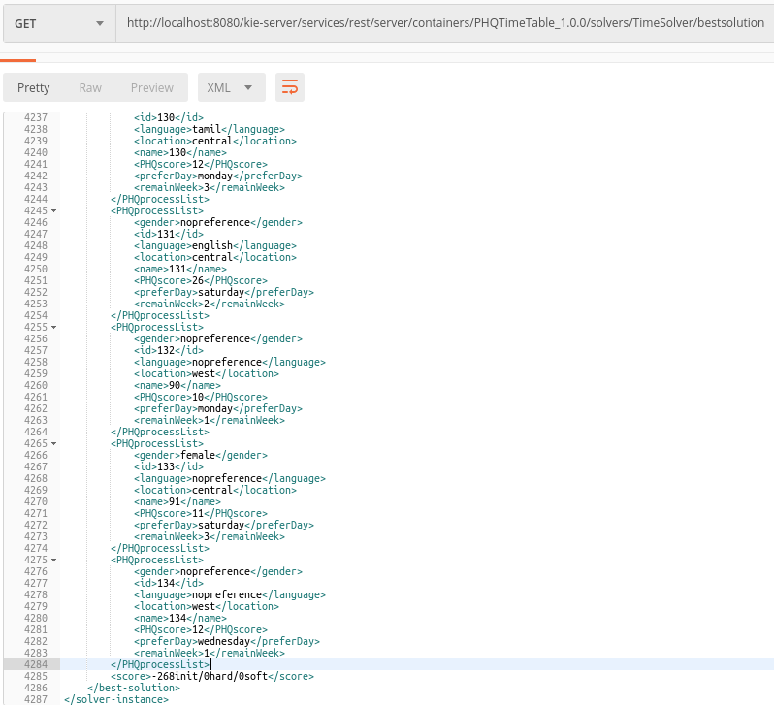
Project Implementation
KIE Workbench Setup
First Fit Decreasing search is fails with this bigger data set of 137 practitioners and 134 patients

Slide 19
Project Implementation
KIE Workbench Setup
Hence, a local search is added, and Late Acceptance search is chosen in this case.
By adding Late Acceptable search after first fit, we aim to generate a solution for 137 practitioners and 134 patients.

Slide 20
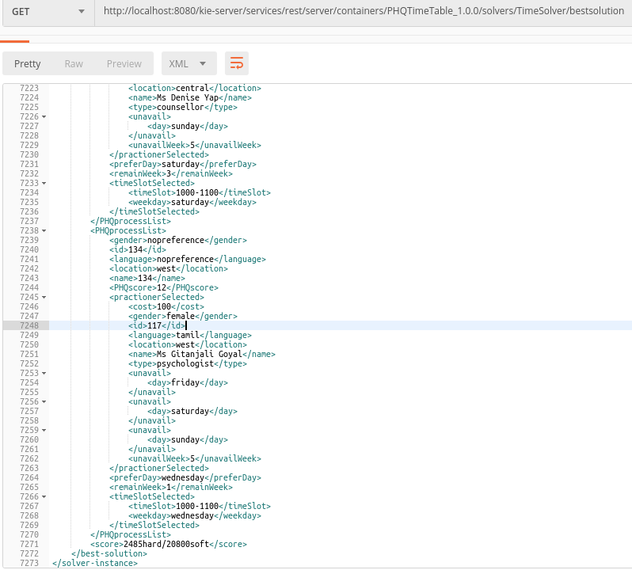
Project Implementation
KIE Workbench Setup
Outcome for First Fit Decreasing with Late Acceptance search is Positive with this bigger data set of 137 practitioners and 134 patients

Slide 21
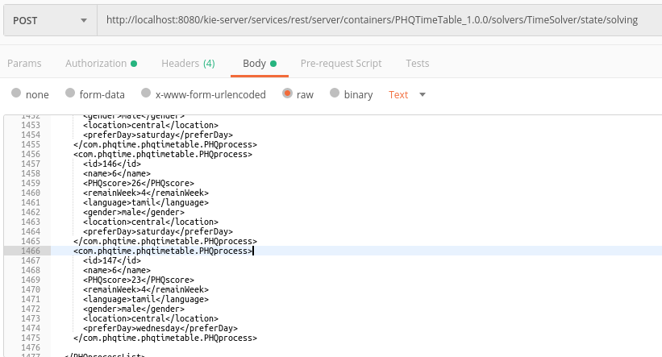
Project Implementation
KIE Workbench Setup
Traditional Hill Climbing has the tendency to be stuck at local optimum but Late Acceptance Hill Climbing increases the chance the to find the global optimum.

Slide 22
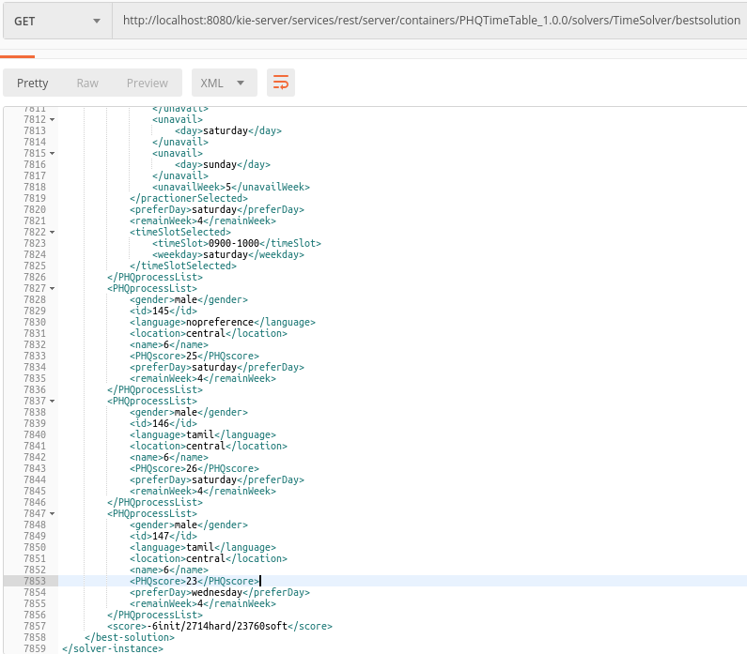
Project Implementation
KIE Workbench Setup
Result showing that Hill Climbing getting stuck at local optimum.

Slide 23
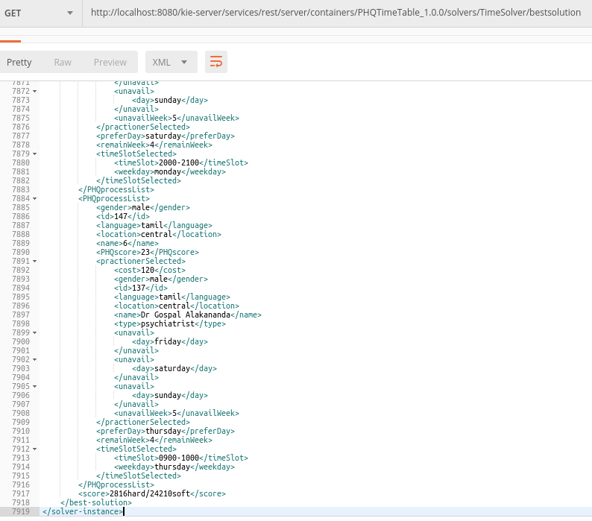
Project Implementation
KIE Workbench Setup
Result showing Late Acceptance Hill Climbing solving the problem.

Slide 24
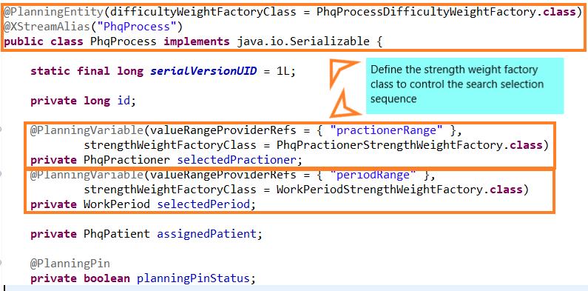
Project Implementation
Search Design
From our earlier tests, it is observed that the First Fit algorithm provides a fast but often non-optimal solution. The algorithm can be made much more effective by first sorting the list of elements into decreasing order, as in First Fit Decreasing.
We learnt that some optimization algorithms work more efficiently when we identify which planning entities are more difficult to plan. In our case, these planning entities are practitioner and work period.
Our team has created some Java classes (working in tandem with Optaplanner) to execute based on First Fit Decreasing. Following shows the Java class encapsulating both planning variables – for practitioner and for work period.

Slide 25
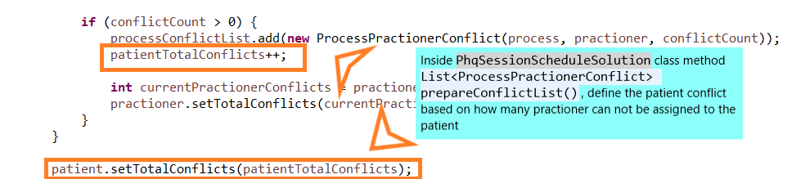
Project Implementation
Search Design
The following logic helps to ensure that we match those patients with the least number of assignable practitioners first as they are more difficult to match.

Slide 26
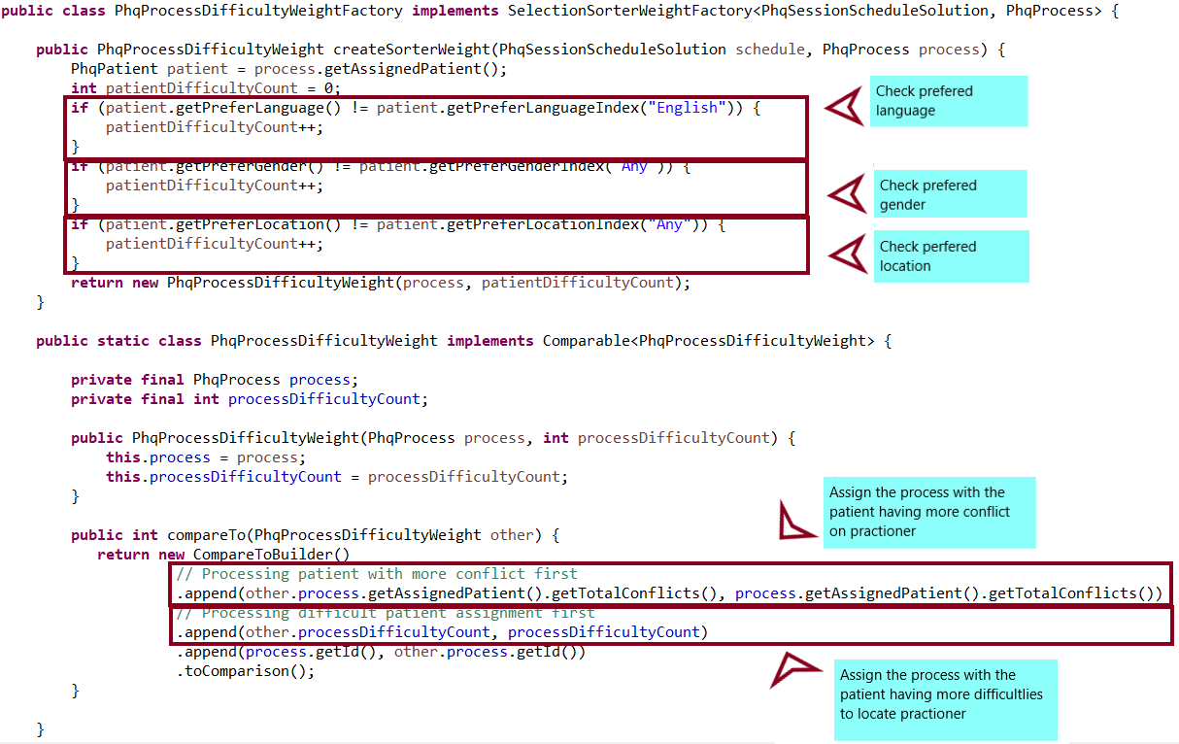
Project Implementation
Search Design
The following serves to match those patients with more constraints first.

Slide 27
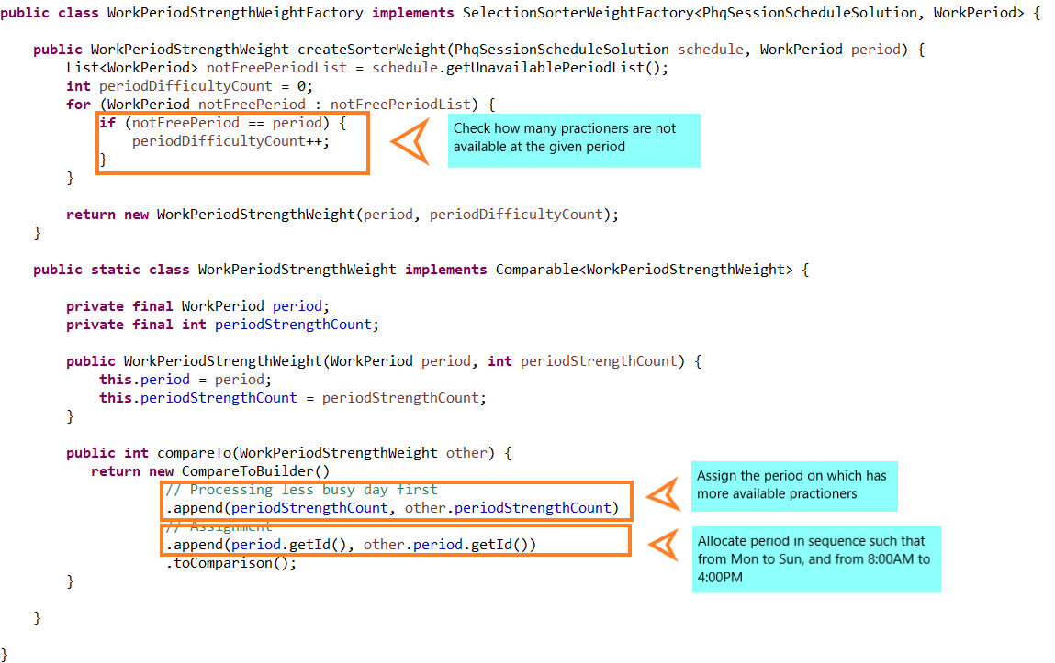
Project Implementation
Search Design
Here, patients are assigned slots starting from beginning of week and from earlier time of day onwards.

Slide 28
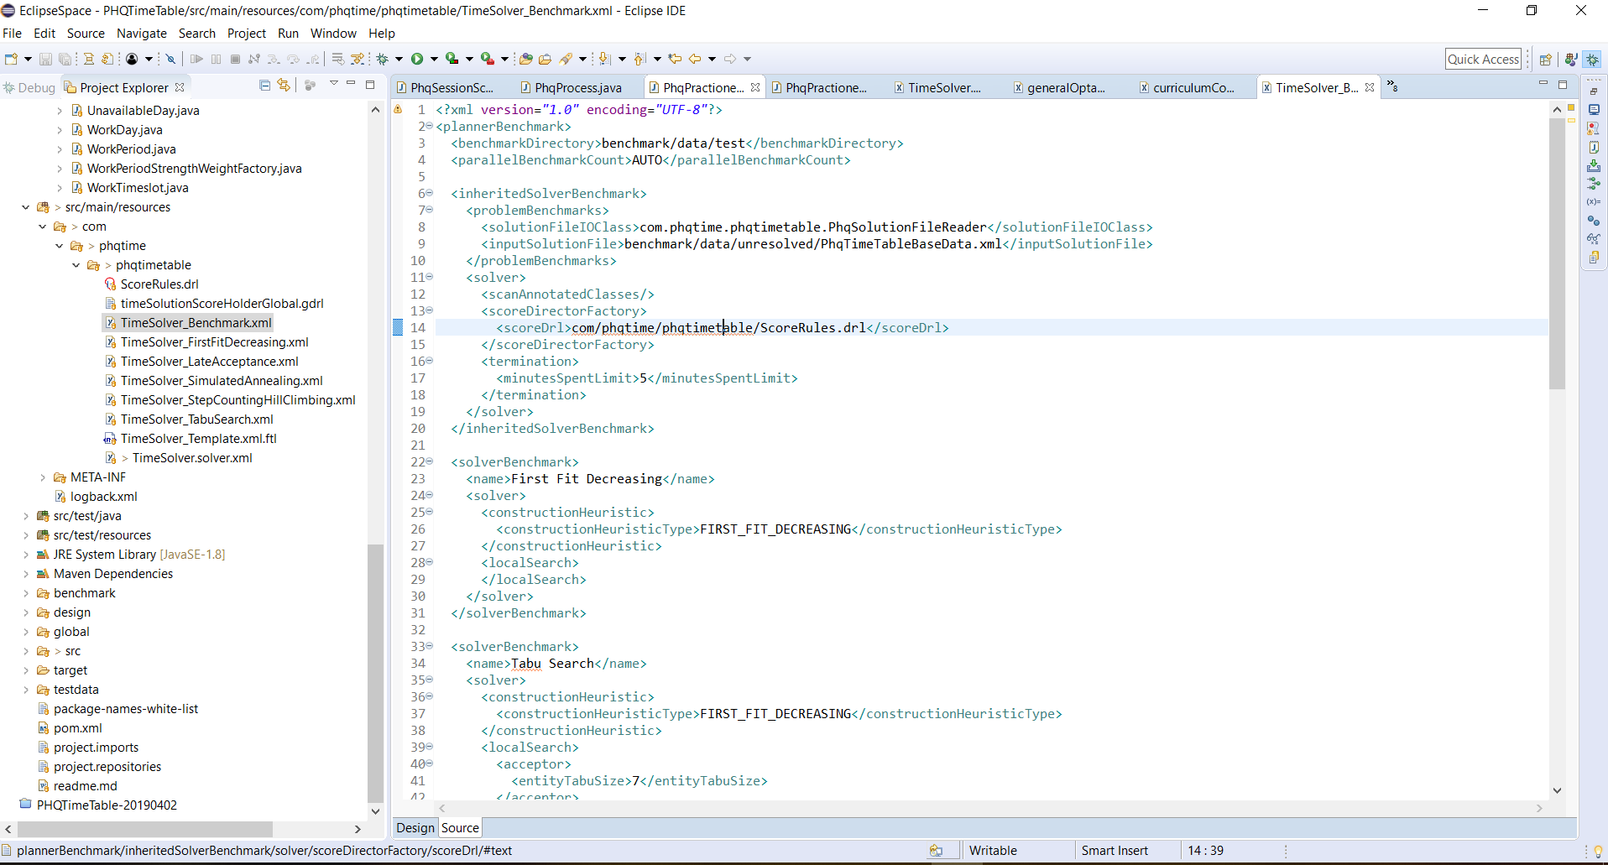
Project Performance & Validation
Benchmark
In the Eclipse environment, we have created an XML program to test the various search algorithms. This serves to benchmark the performance of each search method which is outlined on the next page.

Slide 29
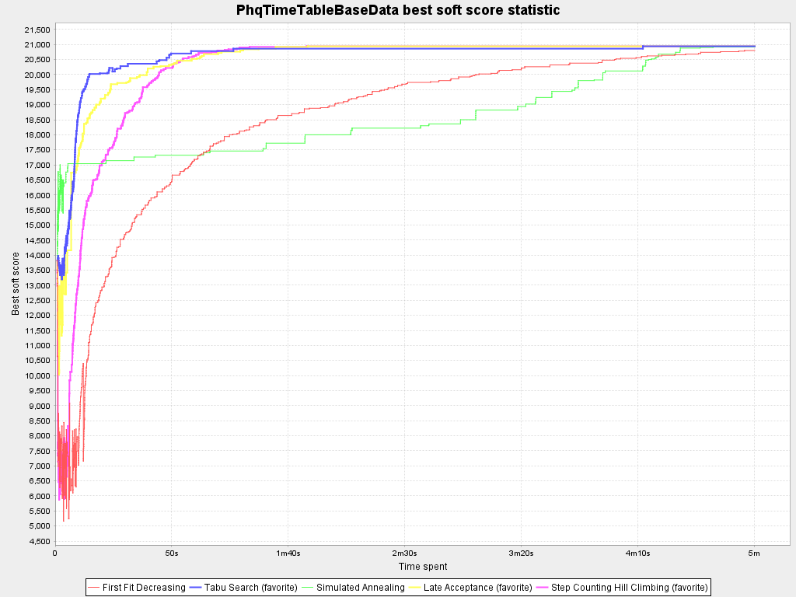
Project Performance & Validation
Benchmark
A benchmark test was conducted against the various search algorithms as follows. We have made some observations as follows. All hard constraints are met. The level of soft constraints being met varies across the different search algorithms.
First Fit Decreasing
This is the slowest search algorithm in our scenario. This demonstrates a key characteristic of construction heuristic vs metaheuristic.
Tabu Search
This search made the fastest progress in the beginning but took a long time to converge into global optimum compared to Late Aceptance.
Simulated Annealing
This is the slowest search.
Late Acceptance
This is the fatest to reach the global optimum.
Step Counting Hill Climbing
This has reasonable performance and reaches global optimum quite fast.

Slide 30
Project Conclusions: Findings & Recommendation
We have met the prescribed objective of this project and that is to optimally match a group of patients with a group of practitioners, within boundary of hard constraints and with optimal compliance to soft constraints. In addition, we have employed the different search algorithms to understand the characteristics of each of them.
Hence, we consider this application to be more than meeting the objectives and ready to be adapted for a real world requirement.

